Slide 1



EV Charging Demand
Compiled By:
Bhavana Sharma
Student ID: STU6862cc3730e031751305271
Internship ID: INTERNSHIP_175040797468551b2636342

Slide 2

Learning Objectives
Understand the trends and growth patterns of Electric Vehicle (EV) adoption from 2017–2024.
Learn how to preprocess, clean, and analyze EV population data.
Identify top regions (countries and states) with high EV penetration.
Understand the impact of lag features and time-series trends on EV forecasting.
Build a regression model to predict EV adoption for the next 3 years.
Provide actionable insights for policymakers on charging infrastructure planning.
EV Charging Demand
GOAL
Source :
Dataset: Washington State Department of Licensing (via Kaggle) - Data range: Jan 2017 – Feb 2024
Link: https://www.kaggle.com/datasets/sahirmaharajj/electric-vehicle-population-size-2024/data
Images sourced from www.freepik.com for visualization.

Slide 3
Tools and Technology used
Programming language: Python 3.12.8
Libraries used:
Python 3, Pandas, NumPy for data handling.
Seaborn, Matplotlib for visualizations.
Scikit-learn for machine learning modeling (Random Forest Regressor).
Environment: Kaggle Notebook for code execution.

Slide 4
Methodology
Data Collection
Import Libraries
Load and understand dataset.
Handle missing values, outliers, and incorrect data types.
Perform Exploratory Data Analysis (EDA).
Engineer lag features and growth slope.
Train regression model using Random Forest.
Evaluate model with metrics (MAE, RMSE, R²).
Forecast EV adoption for next 3 years.

Slide 5
Problem Statement
As electric vehicle (EV) adoption accelerates across regions, inadequate planning for charging infrastructure could lead to delays, user dissatisfaction, and hindered sustainability goals.
Leveraging EV datasets containing population counts, vehicle types, and historical trends, a forecasting model is required to predict future EV growth.
Reliable forecasts will help policymakers and urban planners anticipate infrastructure needs, prioritize high-adoption areas, and prevent potential bottlenecks in charging availability.

Slide 6
Solution
Use historical registration data to build a time-series regression model.
Identify top EV-adopting countries to prioritize infrastructure needs.
Forecast monthly and cumulative EV counts for the next 36 months.
Incorporate seasonality and lag features to improve forecasting accuracy.
Provide county-wise projections to assist policymakers in charging station planning.

Slide 7
About the Dataset
Dataset: This dataset shows the number of vehicles that were registered by Washington State Department of Licensing (DOL) each month. The data is separated by county for passenger vehicles and trucks.
Date: Counts of registered vehicles are taken on this day (the end of this month). - 2017-01-31 2024-02-29
County: This is the geographic region of a state that a vehicle's owner is listed to reside within. Vehicles registered in Washington
State: This is the geographic region of the country associated with the record. These addresses may be located in other
Vehicle Primary Use: This describes the primary intended use of the vehicle.(Passenger-83%, Truck-17%)
Battery Electric Vehicles (BEVs): The count of vehicles that are known to be propelled solely by an energy derived from an onboard electric battery.
Plug-In Hybrid Electric Vehicles (PHEVs): The count of vehicles that are known to be propelled from energy partially sourced from an onboard electric battery
Electric Vehicle (EV) Total: The sum of Battery Electric Vehicles (BEVs) and Plug-in Hybrid Electric Vehicles (PHEVs).
Non-Electric Vehicle Total: The count of vehicles that are not electric vehicles.
Total Vehicles: All powered vehicles registered in the county. This includes electric vehicles.
Percent Electric Vehicles: Comparison of electric vehicles versus their non-electric counterparts.

Slide 8
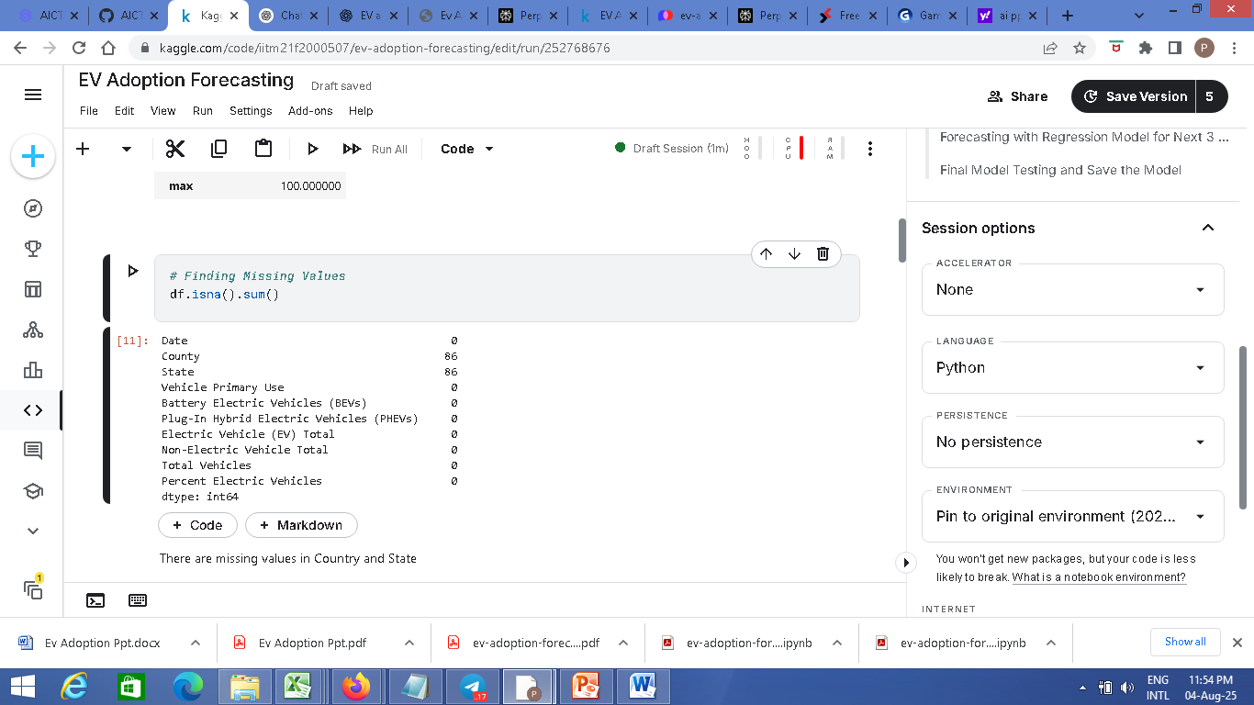
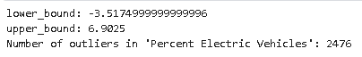
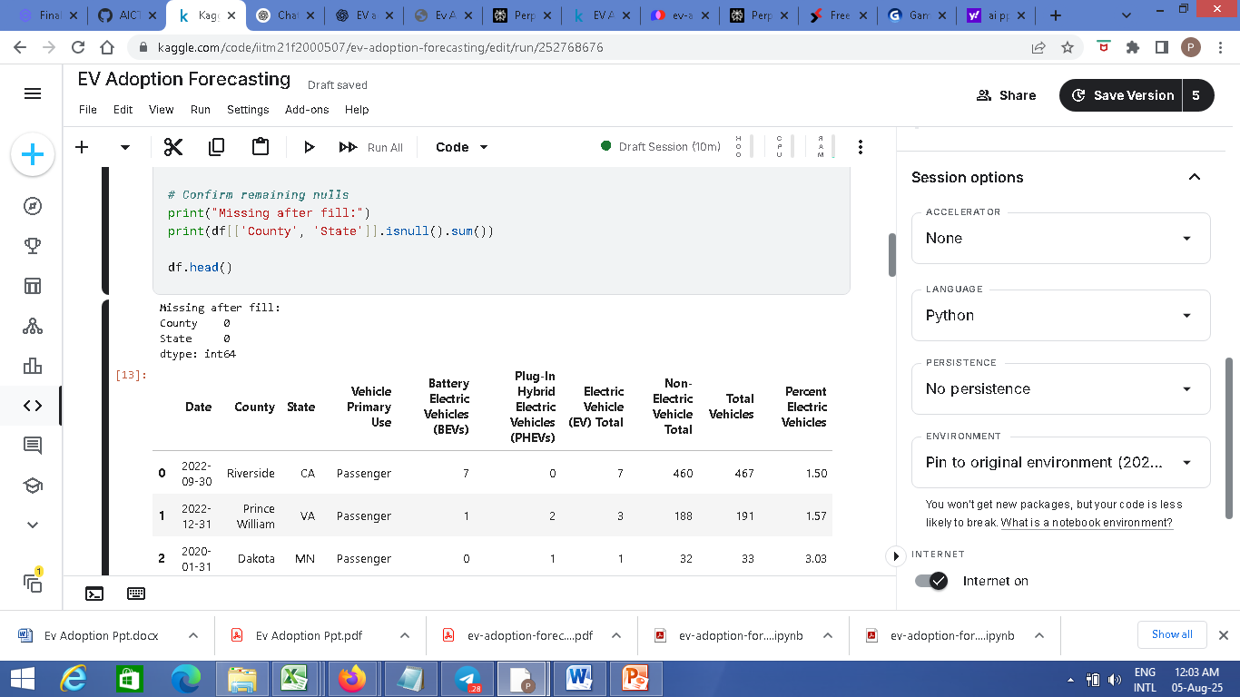
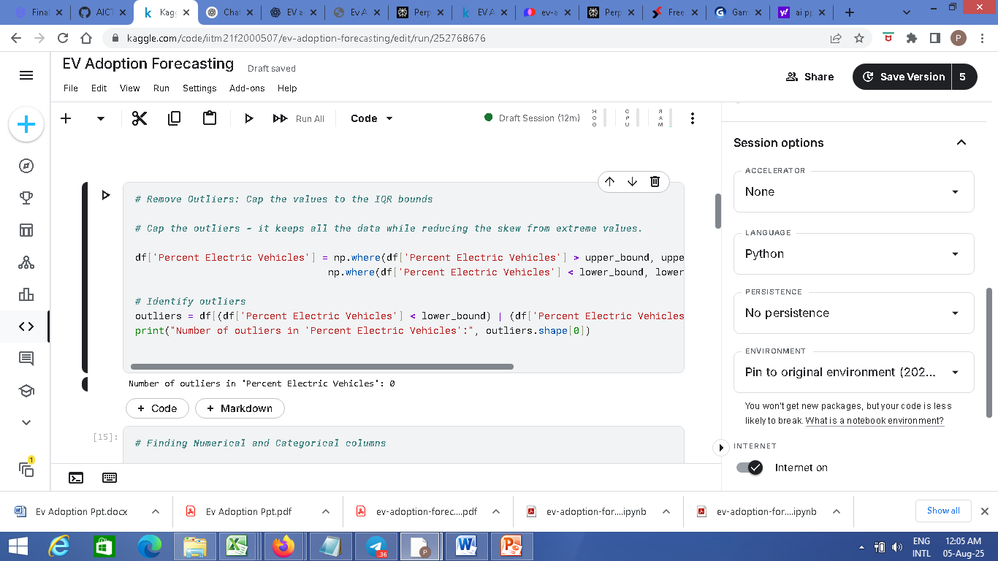
Data Pre-processing
Missing values in County/State filled as ‘Unknown’.
Numeric conversion of all vehicle count columns.
Outliers capped using IQR method.
Date column converted to datetime for time-series analysis.
Fig: Finding outliers and removing them
Fig: Finding missing values and filled as Unknown

Slide 9
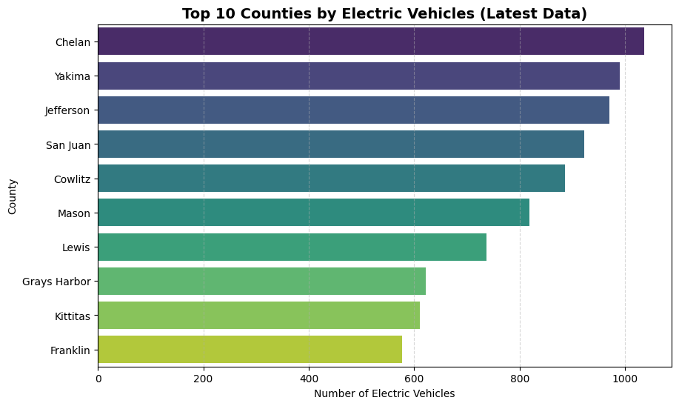
Exploratory Data Analysis:
Top 10 Countries by EV Adoption:
Chelan leads with the highest EV count (>1,030).
Yakima & Jefferson close behind (~1,000 EVs).
Mid-tier adoption: San Juan, Cowlitz, Mason (800–900 EVs).
Lower adoption: Lewis, Grays Harbor, Kittitas, Franklin (<750 EVs).
Gap shows scope for incentives & charging infrastructure in trailing countries.
Fig: Top 10 countries adopting EVs

Slide 10
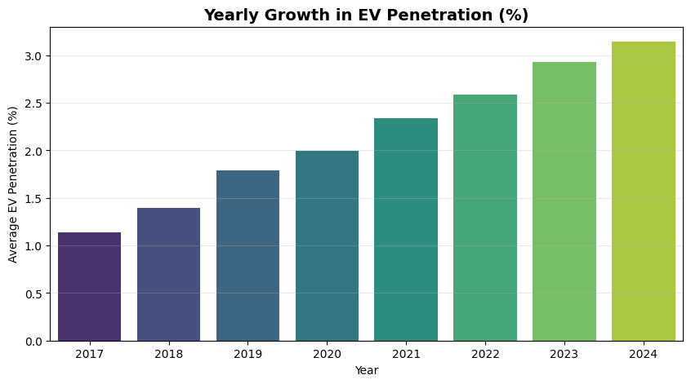
Exploratory Data Analysis:
Yearly Growth:
Steady growth from 1.1% (2017) to 3.2% (2024).
Rapid rise post-2019, showing increased EV adoption.
Consistent upward trend, indicating strong future potential.
Policy & infrastructure support likely driving acceleration.
Fig: Yearly Growth in EV Penetration

Slide 11
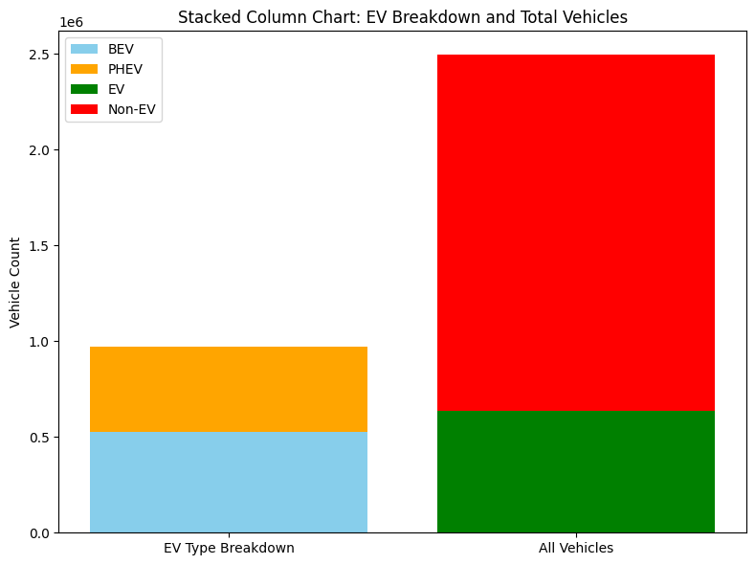
Exploratory Data Analysis:
EV Breakdown and Total Vehicles:
EVs remain a small share compared to non-EVs.
Battery EVs dominate over Plug-in Hybrids in EV composition
High non-EV dominance shows large untapped market potential.
Scope for rapid EV transition with strong incentives & infrastructure.
Future focus on BEV expansion can accelerate the shift from traditional vehicles
Fig: EV Breakdown and All Vehicles

Slide 12
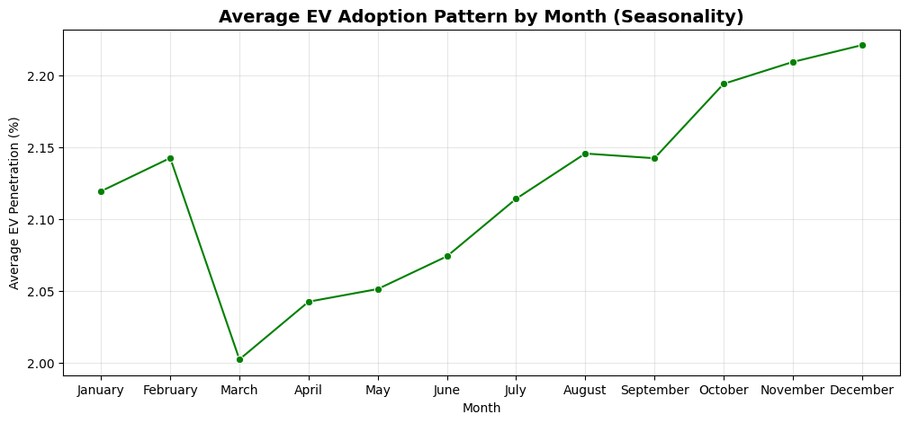
Exploratory Data Analysis:
Seasonality:
Higher EV penetration in specific months.
Dip in March, lowest adoption.
Rises steadily Apr–Dec.
Peak in Dec (~2.22%).
Year-end boost due to offers & incentives.
Q4 strongest growth trend.
Fig: Monthly EV Adoption Pattern

Slide 13
Feature Engineering
Lag features (1, 2, 3 months). - Rolling 3-month average.
Percent changes for 1-month and 3-month intervals.
EV growth slope over 6 months. - Cumulative EV count trend per county.
Model
Random Forest Regressor chosen for handling non-linear patterns.
Hyperparameter tuning via RandomizedSearchCV.
Cross-validation to avoid overfitting.
Features: lags, rolling mean, percent changes, growth slope, county encoding.

Slide 14
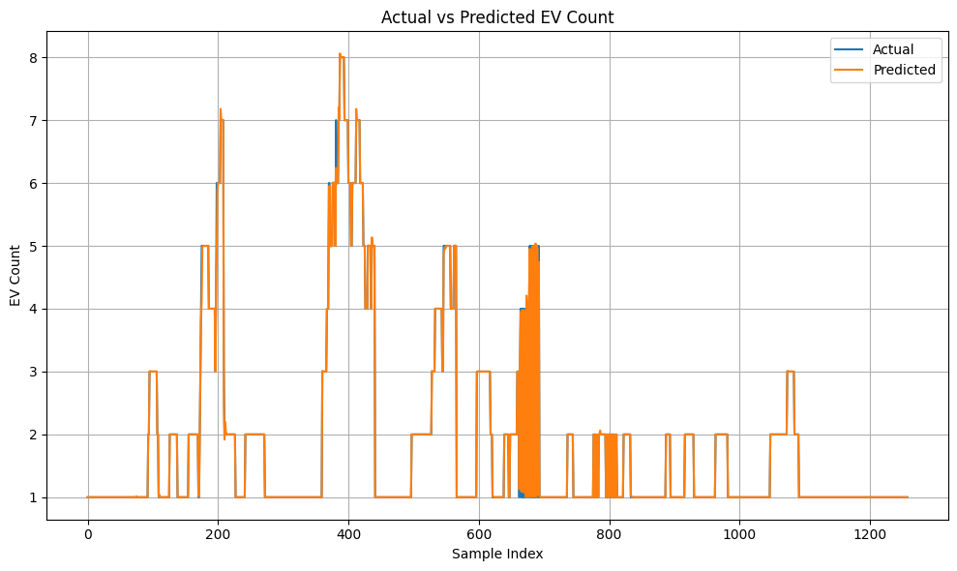
Model Evaluation
MAE: 0.01, RMSE: 0.06, R² = 1.00 (High accuracy).
Actual vs Predicted EV Count graph shows strong model performance.
Feature importance highlights lag2, lag1, and growth slope as most predictive.
Fig: Actual vs Predicted EV Count

Slide 15
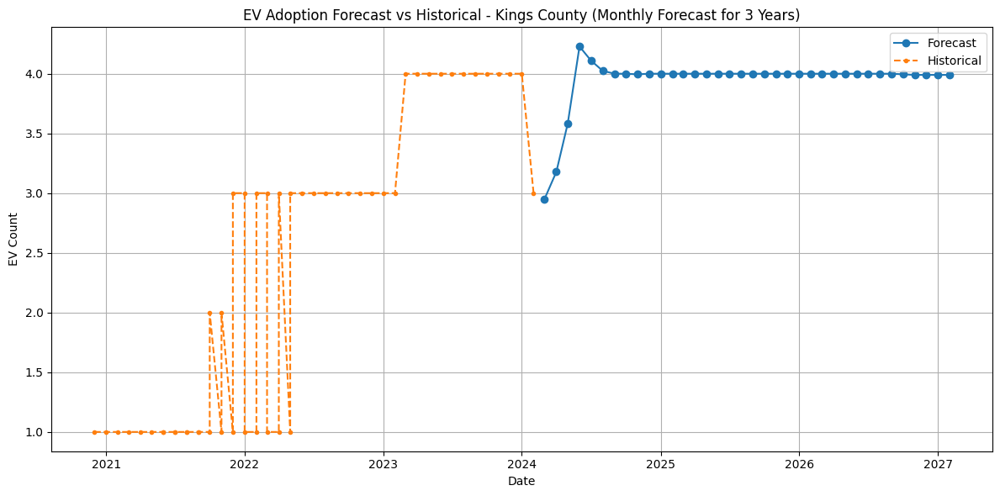
Forecasting
Kings County –
Linear EV growth predicted 2024–2027.
Cumulative EV count expected to double.
Infrastructure upgrades necessary to meet demand.
Fig: Kings County – Monthly Forecast for 3 years

Slide 16
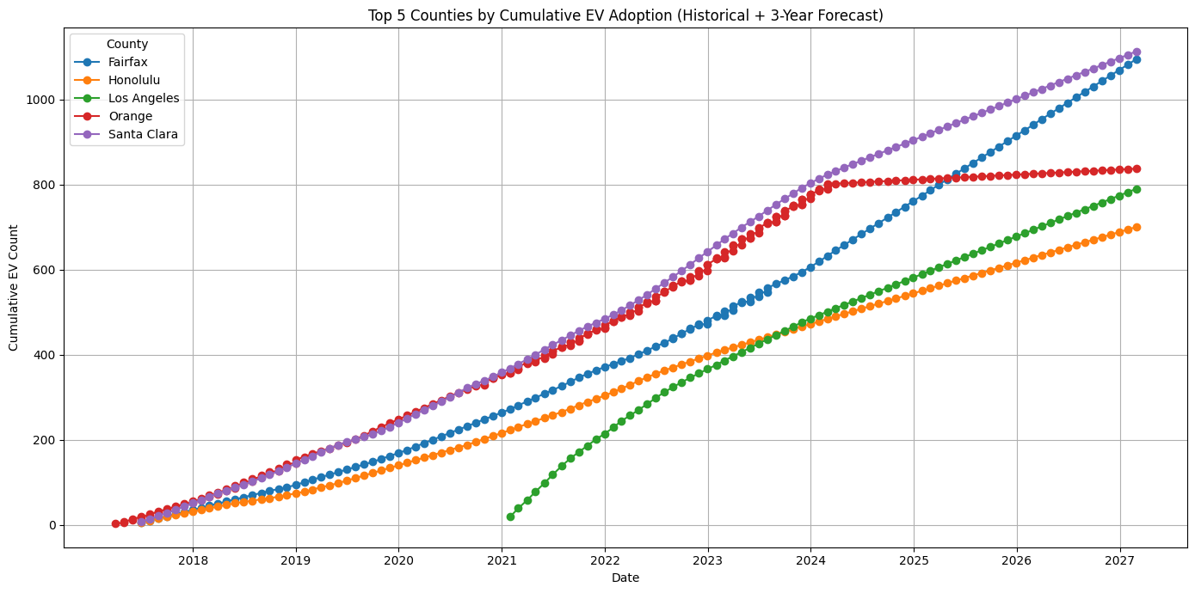
Forecasting
Top 5 Countries –
Santa Clara and Fairfax show highest growth momentum.
Orange County growth may plateau.
Honolulu and Los Angeles maintain moderate growth.
Graph shows combined historical + 3 year forecast data.
Fig: Top 5 Countries by Cumulative EV Adoption

Slide 17
Conclusion
Consistent upward trend shows EV adoption is accelerating annually.
EV adoption increasing rapidly across all regions.
BEVs dominate growth, indicating a shift toward full-electric vehicles over hybrids.
Lag features crucial in accurate forecasting.
Forecast indicates doubling EV count in leading countries by 2027.
Data-driven forecasting enables better infrastructure allocation and investment planning.
Results assist policymakers in planning charging stations and grid expansions.

